Slide 1

Deploying Microsoft Azure Stack Hub
Understanding the Azure Stack Hub Deployment Process
This work is licensed under a Creative Commons Attribution - ShareAlike 4.0 International Public License

Slide 2
Agenda
Deployment preparation
Required data, deployment considerations
HLH and DVP deployment
Set up HLH, deploy DVM and Azure Stack Hub
Deploy Azure Stack Hub
Deployment process, deployment file, scale considerations
Post-deployment and troubleshooting
Critical decisions

Slide 3
Why is this important?
Azure Stack Hub deployments will not be performed by end customers like traditional on-premises products or solutions from Microsoft
Acquisition and deployment requires a relationship between Microsoft and your selected OEM partners
This section is designed provide you with a high-level understanding of the deployment process being performed

Slide 4
Azure Stack Hub Deployment Information Gathering

Slide 5
Azure Stack Hub Deployment Journey
 | Evaluation | Order | Pre-Integration | H/W delivery | Onsite Deployment
Customer
H/W Partner
Microsoft
Evaluate
Purchase
Collect Deployment Info
Receive H/W
Ready for deployment
Provide guidance
Create PO
Provide technical support
Ship the H/W to customer site.
Onsite deployment
Provide guidance
Engage as needed
Provide tooling &
documentation
Provide support

Slide 6
Understanding the OEM deployment process
Azure Stack Hub is provided as an integrated system
OEM partners are responsible for the following deployment activities:
Hardware Deployment
OEM and Microsoft Support Onboarding
Azure Stack Hub Platform Deployment
Basic integration services (such as networking)

Slide 7

Solutions Specifics
Rack Dimensions and Weight
Re-Racking
PDU Models US or EU
Power Requirements, UPS
Power Cables 2 Phase, 3 Phase
Cooling Requirements
Contact our hardware partners for details

Slide 8
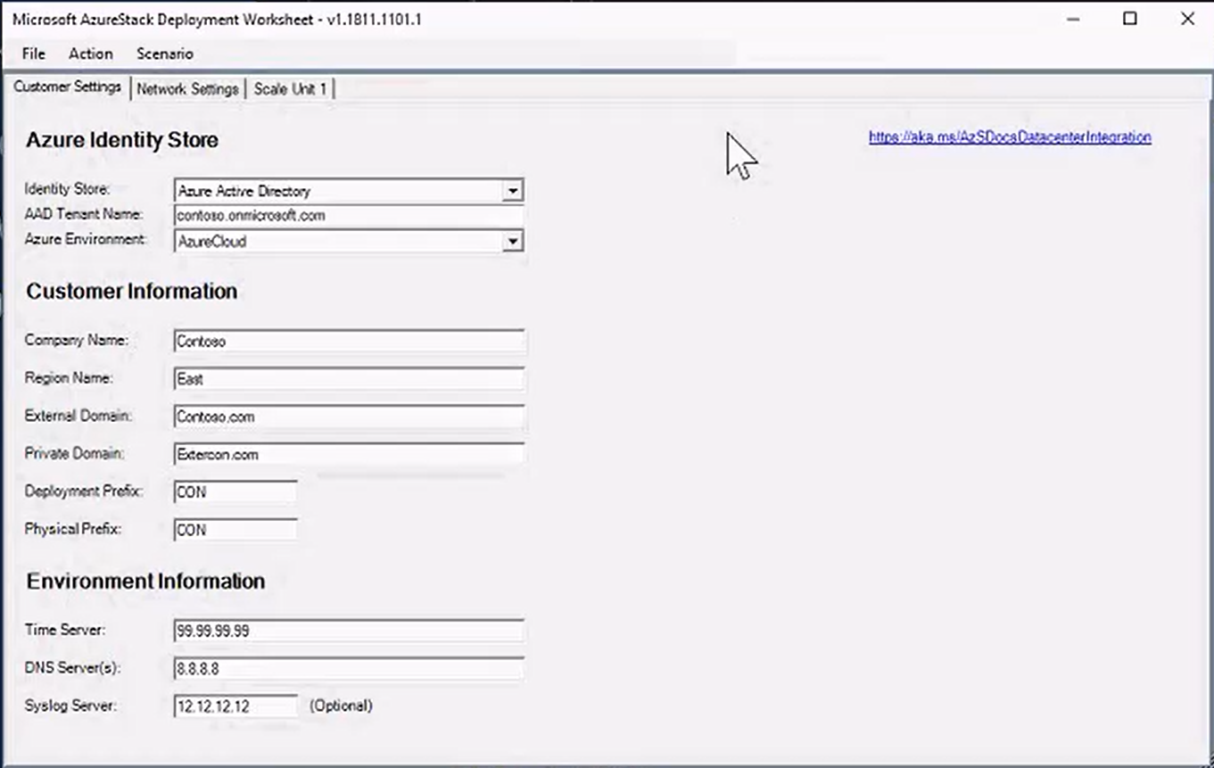
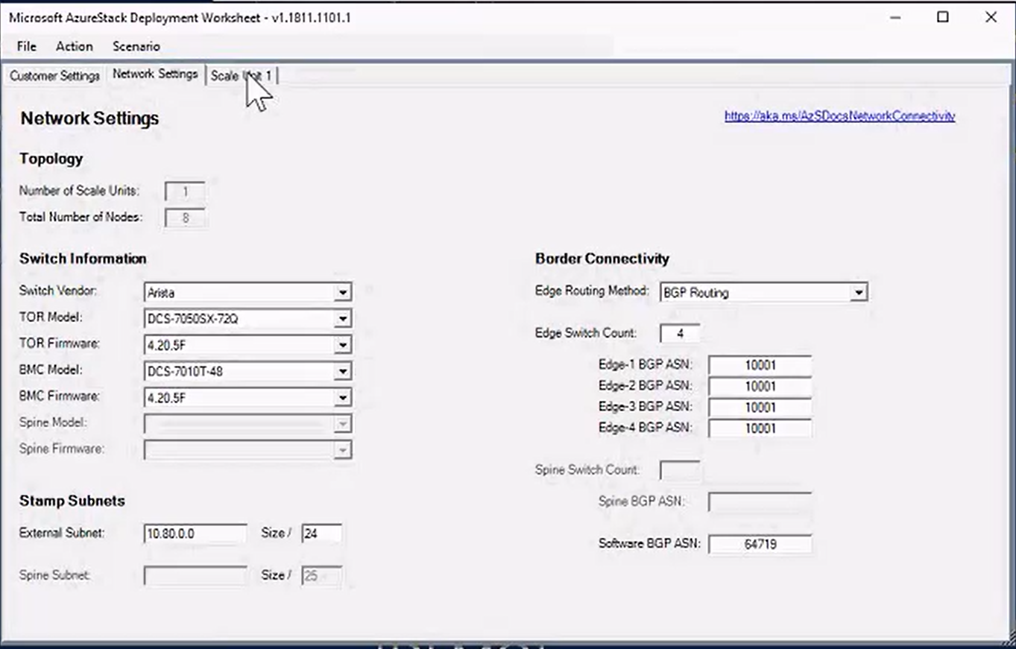
Azure Stack Hub deployment information gathering
Azure connection
Identity store
Billing model
Customer information
Environment information
Network settings

Slide 9
Azure Stack Hub deployment information
Environment information
DNS forwarder
Time synchronization
Customer information
Company name
Region name
External domain name
Etc.

Slide 10
Azure Stack Hub Deployment Process

Slide 11
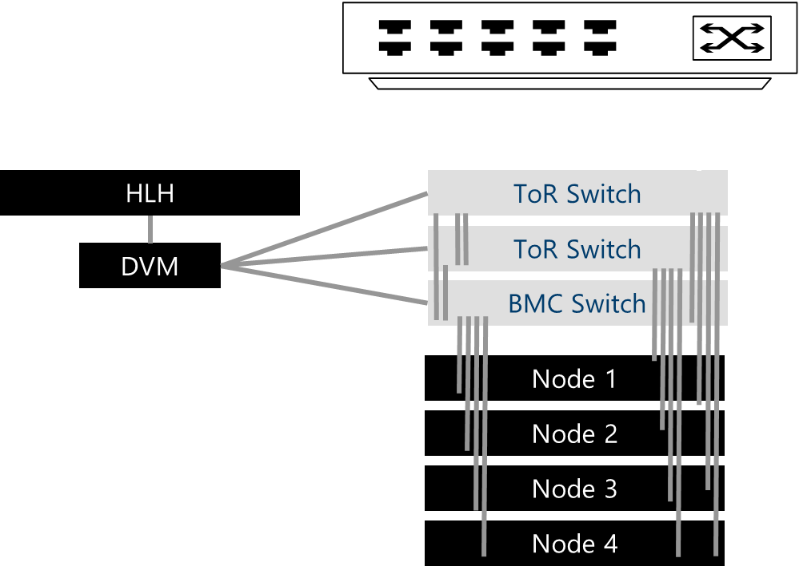
Deployment process - general
Azure Stack Hub multi-node deployment
Key Terms
HLH The Hardware Lifecycle Host is an additional physical machine used for the deployment and other services from the Hardware Vendor.
DVM The Deployment Virtual Machine is a virtual machine running on the HLH where the Azure Stack Hub deployment will be triggered. During the deployment, the DVM will become AD DC, WDS, DHCP.
After deployment, the DVM is no longer needed and will be removed.

Slide 12
Deployment process - HLH
HLH
HLH = Hardware Lifecycle Host
Separate box shipped with each Scale Unit
Used for the initial Azure Stack Hub deployment
Also used for 3rd-party applications from the Hardware Vendor
Not all Hardware Vendors will have HLH

Slide 13
Deployment process – Deployment VM
DVM
Built as a Virtual Machine (Hyper-V) on the HLH
The Azure Stack Hub deployment is started from within the DVM
During the set up, it‘s temporarily used for AD, WDS, DHCP, and others
The DVM will be deleted after successful deployment

Slide 14
Creation of the deployment VM (DVM)
.\InitializeAzureStackDeployment.ps1 `
-ComputerName <dvmname> `
-LocalAdministratorPassword <dvmpass> `
-IPAddress <dvmip> `
-DVMHostMACAddress <mac> `
-NetMask <subnetmask> `
-DefaultGateway <dvmgateway> `
-VlanId <vlanid> `
-OemIsoPath <oemiso> `
-Verbose
Parameter | Description
ComputerName* | Name of the DVM VM
LocalAdministratorPassword | Local Administrator Password
IPAddress | IP-Address of the DVM
NetMask | Subnetmask of the DVM
DefaultGateway | Default Gateway
VlanId | VLAN ID for DVM
OemIsoPath | OEM ISO Path (Driver Disk)
Verbose | Run Script in Verbose Mode

Slide 15
Azure Stack Hub Installation Process

Slide 16
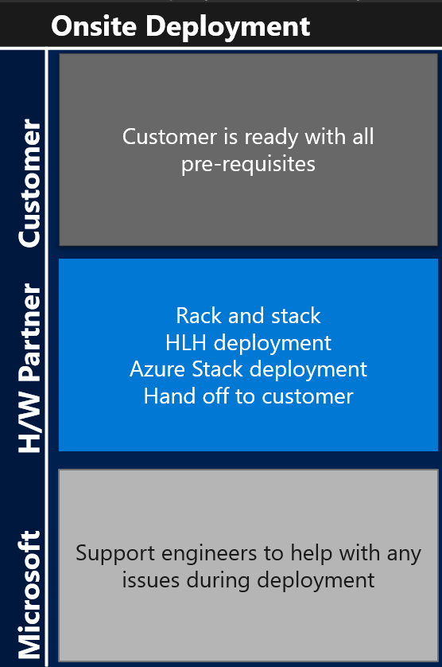
Onsite Deployment
Important: make sure all information provided has not changed
Ensure the onsite engineer has all the required access and clearance.
The onsite H/W engineer will:
Rack the solution
Integrate to your border devices
Prepare the HLH
Update all the BMC and Firmware to all hosts.
Kicks off deployment
Install the latest update
Tests Azure Stack Hub post deployment
Register Azure Stack Hub
Hands off the solution to you
Microsoft support engineers are ready to help with any unforeseen issues.

Slide 17
Install Azure Stack Hub – the beginning
The deployment will be started from the DVM
The driver package is specified at DVM creation
Different parameters for ADFS and AAD deployments
Pass configuration using parameters or JSON

Slide 18
Install Azure Stack Hub – It‘s a PowerShell script
InstallAzureStack.ps1 `
-InfraAzureEnvironment "AzureCloud" -CompanyName "<..>" `
-InfraAzureDirectoryTenantName "<..>.onmicrosoft.com" `
-InfraAzureDirectoryTenantAdminCredential <..> `
-DomainFQDN <..> -DomainAdminCredential <..> `
-BareMetalCredential <..> -NamingPrefix <..> `
-TimeZone <..> -TimeServer <..> -EnvironmentDNS <..> `
-TORSwitchBGPASN <..> -SoftwareBGPASN <..> `
-TORSwitchBGPPeerIP <..> -InfrastructureNetwork @{Subnet=<..>} `
-StorageNetwork @{Subnet=<..>; vlanId=<..>} `
-InfrastructureExtendedNetwork @{Subnet=<..>} `
-ExternalNetwork @{Subnet=<..>} -RegionName "<..>" `
-PhysicalNodes @( @{ Name=".."; BMCIPAddress="<..>"; MACAddress="<..>"},
@{ Name=".."; BMCIPAddress="<..>"; MACAddress="<..>" },
@{ Name=".."; BMCIPAddress="<..>"; MACAddress="<..>" },
@{ Name=".."; BMCIPAddress="<..>"; MACAddress="<..>" } )

Slide 19
Install Azure Stack Hub (with ADFS)
InstallAzureStack.ps1 `
-DomainAdminCredential $domainCred `
-BMCCredential $bmcCred `
-CompanyName "<..>" -RegionName "<..>" `
-ExternalDomainFQDN "<..>" `
-DomainFQDN "<..>" -DNSForwarder @("<..>", "<..>") `
-TimeServer "<..>" -TORSwitchBGPASN <..> `
-SoftwareBGPASN <..> -TORSwitchBGPPeerIP "<..>" `
-StorageNetwork @{ Subnet = "<..>"; VlanId = 1 } `
-InfrastructureNetwork @{ Subnet = "<..>" } `
-ExternalNetwork @{ Subnet = "<..>" } `
-InfrastructureExtendedNetwork @{ Subnet = "<..>" } `
-PhysicalNodes @( @{ Name=".."; BMCIPAddress="<..>"; MACAddress="<..>"},
@{ Name=".."; BMCIPAddress="<..>"; MACAddress="<..>" },
@{ Name=".."; BMCIPAddress="<..>"; MACAddress="<..>" },
@{ Name=".."; BMCIPAddress="<..>"; MACAddress="<..>" } )
-UseADFS

Slide 20
Install Azure Stack Hub - Parameters
Parameter | Description
InfraAzureEnvironment | Default „AzureCloud“
InfraAzureDirectoryTenantName | Tenant Name
InfraAzureDirectoryTenantAdminCredential | Tenant Credentials
CompanyName | Company Name
DomainFQDN | MAS int. Resource Domain
DomainAdminCredential | Admin Credentials
BMCCredential | BMC Credentials
NamingPrefix* | VM Prefix
TimeServer* | time.windows.com
UseADFS* | Using ADFS instead of AAD
ExternalDomainFQDN | DNS Zone for all endpoints
DNSForwarder | Existing DNS servers
Parameter | Description
EnvironmentDNS | Ext. DNS-Servers
TORSwitchBGPASN | ASN for TOR Switch BGP
SoftwareBGPASN | ASN for Software BGP
TORSwitchBGPPeerIP | TOR Switch BGP IP-Addresses
InfrastructureNetwork | Internal MAS VMs (ADDS, CA, ..)
StorageNetwork | CSV, S2D, (not routed)
ExternalNetwork | VIPs e.g. for Azure Portal
InfrastructureExtendedNetwork | Infrastructure Extended Network
PhysicalNodes | see node definition
Verbose | Run in Verbose Mode
RegionName | Azure Stack Hub Region Name
PublicCertificatePath | public facing endpoint certificates
ReRun* | Rerun Deployment (w/o other param)
AAD Deployment only
* optional

Slide 21
Install Azure Stack Hub – Nodes and names
Node definition – Physical nodes
$node1 = @{ Name=„azs-node1"; BmcIPAddress="10.10.34.5"; MacAddress="AB-CD-EF-12-34-56"}
$node2 = @{ Name=„azs-node2"; BmcIPAddress="10.10.34.6"; MacAddress=".."}
$node3 = @{ Name=„azs-node3"; BmcIPAddress="10.10.34.7"; MacAddress=".."}
$node4 = @{ Name=„azs-node4"; BmcIPAddress="10.10.34.8"; MacAddress=".."}
...
$physicalNodes = @( $node1, $node2, $node3, $node4, ..)
Name is auto generated (using a defined prefix) but can be overwritten

Slide 22
Install Azure Stack Hub - Restarting
ReRun
In case of an intermittent environmental issue that has caused the deployment to fail, you can retry the deployment by using the parameter “-rerun” to trigger a deployment rerun.
The deployment automation will skip the steps that have been previously successfully completed and restart at the step that had failed.
Please note that we do not support changing passwords / credentials when using -rerun. If passwords or credentials must be changed, reset the environment and restart the deployment.
InstallAzureStack.ps1 -Rerun

Slide 23
Post Deployment Tasks

Slide 24
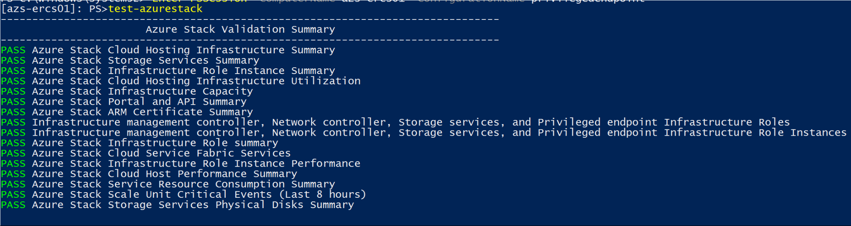
Post-deployment tasks
Test-AzureStack*
Helps to detect failures that are not resulting in cloud outages, such as a single failed disk or a single physical host node failure.
* available in ASDK 1801 or later

Slide 25
Azure Stack Hub PowerShell
There are a number of Azure Stack Hub PowerShell modules that you should obtain from Git hub
https://docs.microsoft.com/en-us/azure/azure-stack/azure-stack-powershell-download
Includes content for:
Cloud capabilities
ARM policy for Azure Stack Hub
Register with Azure
Connect to Azure Stack Hub
ATM template validator

Slide 26
Registration with Azure
Register Azure Stack Hub
Renew / change registration
Decide the Azure subscription for Azure Stack Hub billing association
Obtain agreement number for capacity-based billing model
Obtain Azure Stack Hub Deployment GUID
Register Azure Stack Hub in a connected deployment,
OR
Register Azure Stack Hub from an Internet connected computer in a disconnected deployment
Obtain the activation key
Take the registration string to the Azure Stack Hub system
Activate the system with the registration string.
Renew capacity-based yearly subscription
Change billing model (consumption v.s. capacity)
Scale changes (add/remove nodes) for capacity-based billing
Obtain registration prerequisites
Activate Azure Stack Hub
Register Azure Stack Hub with your Azure Subscription
https://docs.microsoft.com/gl-es/azure/azure-stack/azure-stack-register#disconnected-registration

Slide 27
Obtain registration prerequsites
Azure subscription
Billing model decision (Capacity, Pay-As-You-Use, and Development)
Deployment ID
Note: You must still register disconnected Azure Stack Hub instances (using a special procedure)

Slide 28
Register Azure Stack Hub and obtain activation key
Cmdlet: New-AzureRmAzureStackRegistration
Parameter | Required / Optional | Description
Name | Optional | Friendly name of the Azure Stack Hub system that you’re registering. This can be any string, and should be unique under the same Resource Group.
RegistrationServiceAzureEnvironment | Optional | Sets the Azure environment of where the Azure Stack Hub registration service will be used to register this Azure Stack Hub system. The list of ENUMs are: “AzureCloud”, “AzureChinaCloud”, “AzureGermanyCloud”, “AzureGovernment”. Default to “AzureCloud”.
ResourceGroupName | Optional | Selects the Azure resource group you want to register this Azure Stack Hub system under.
RegistrationType | Required | Sets the Azure Stack Hub system registration type (which indicates the billing model). The list of ENUMs are “POC”, “Consumption”, “Capacity”. No default value. If not provided, the cmdlet will fail.
AzureStackDeploymentID | Required | This is an unique identifier of the Azure Stack Hub system, generated as part of the deployment and can be obtained post a successful deployment.
AgreementNumber | Optional, required only if registration type is “Capacity” | This is the license key the customer must obtain from Microsoft to enable the yearly capacity-based billing model for their Azure Stack Hub system.
StorageAccountForUsageData | Optional | In case the customers want to use a separate storage account for usage data, this is how this information can be passed in.

Slide 29
Activate Azure Stack Hub
Cmdlet: Set-AzureStackActivationKey
Parameter | Required / Optional | Description
ActivationKey | Required | This is the activation key string that is retrieved from the Get-AzureRmAzureStackActivationKey cmdlet after the registration process has been completed.
ConnectToAzure | Optional | This Boolean parameter specifies if you want your Azure Stack Hub solution to connect to Azure. Default value is “True.” If you choose not to connect to Azure, no usage data will be uploaded to Azure and no marketplace syndication will be available either. For an Azure Stack Hub system that is intended to be used for capacity-based billing model, regardless if this is set to true or false, no usage data will be sent. However, if this parameter is set to False, no marketplace syndication will happen for the solution either, even if the solution is configured to be able to access Azure from network connectivity point of view.

Slide 30
Renewing and changing registration
The following events will trigger the need for a registration update or renewal:
Renew capacity-based yearly subscription
Change billing model (consumption vs. capacity)
Scale changes (add / remove nodes) for capacity-based billing

Slide 31
App Service and SQL/mySQL Resource Providers
Installation of the App Service and SQL/mySQL Resource Providers is not part of the core Azure Stack Hub deployment
You should download and install one or both of these
Each of them requires planning and configuration decisions (like where to host the SQL database that the SQL RP will use to create databases for tenants).
More details in the PaaS module coming up later

Slide 32
Post-deployment tasks
Visit AzureStack-Tools Github: https://github.com/Azure/AzureStack-Tools
Examples
Enable syndication by registering with Azure: https://github.com/Azure/AzureStack-Tools/blob/master/Connect
Add VM images to the gallery: https://github.com/Azure/AzureStack-Tools/blob/master/ComputeAdmin
Create and manage identity: https://github.com/Azure/AzureStack-Tools/blob/master/Identity

Slide 33
Integration with monitoring solutions
OEMs responsible for agentless HW device monitoring
Vendor-specific solutions
Deployed on the Hardware Lifecycle Host (HLH)*
“Call home“ option to order spare parts
* Cisco will not have the traditional HLH

Slide 34
ITSM integration
Enable IT Service Management by adopting existing pipes/processes
Monitor with existing datacenter monitoring tooling
Use existing connections from Monitoring to Ticketing, and others
Integrated System
Azure Stack Hub Software*
*including Storage
Physical Server
Network Devices
BMC
Rest API
IPMI
SNMP
Monitoring Solution
Hardware Lifecycle Host
Ticketing, CMDB…
Only if it is supported by OEM vendor

Slide 35
Integration with monitoring solutions
Azure Stack Hub software – API
Nagios Plugin (for Open Source & Enterprise Edition) (Available today http://aka.ms/masnagios)
API Examples & Documentation for custom integration (Soon available on GitHub)
System Center Operations Manager – Management Pack
Physical server – BMC
System Center Operations Manager – Hardware Vendor Management Pack
Hardware Vendor Nagios Plugins
Other OEM supported monitoring solutions
Network devices – SNMP
System Center Operations Manager – Network Device Discovery
Nagios Switch Plugin
Other OEM-supported monitoring solutions
Tenant subscription health monitoring
System Center Operations Manager – Azure Management Pack
Operations Management Suite (OMS)

Slide 36
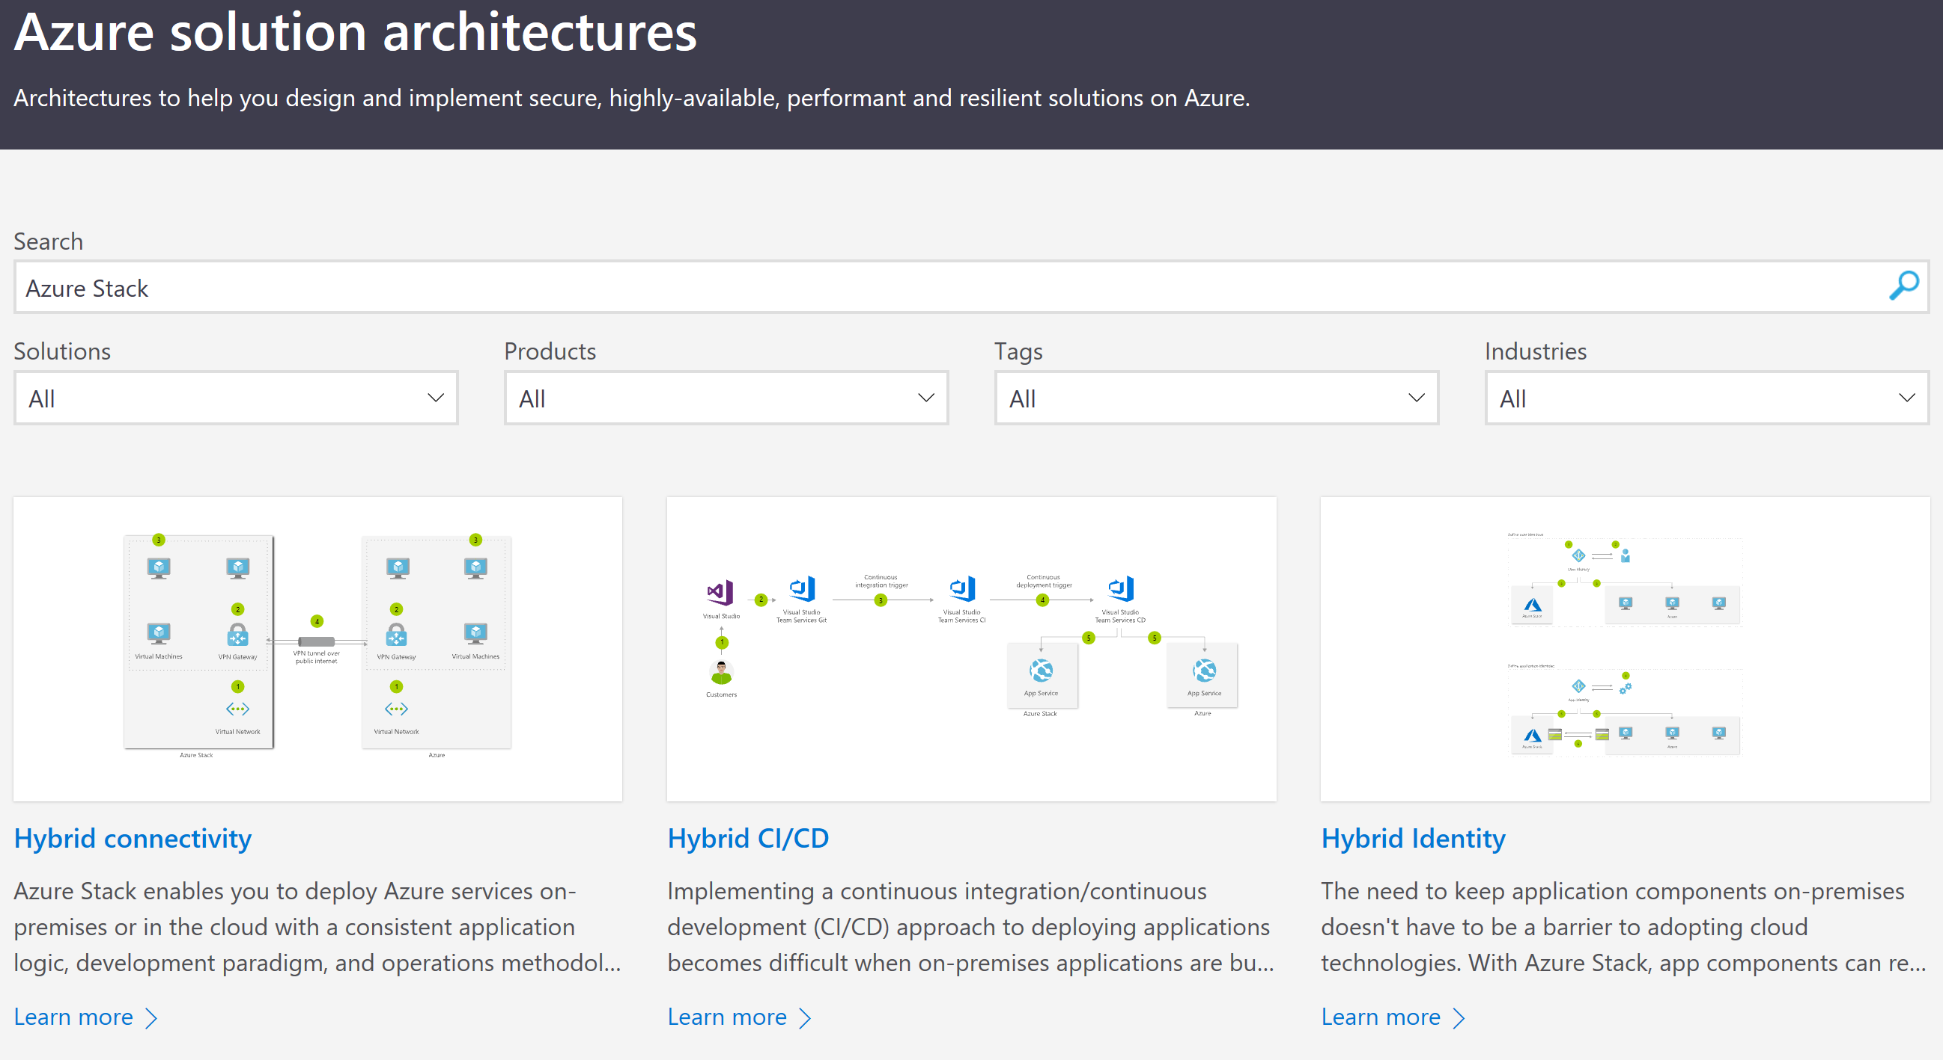
Foundational patterns for Azure Stack Hub
https://azure.microsoft.com/en-us/solutions/architecture/?query=Azure+Stack

Slide 37

Hybrid cloud solutions (from microsoft.com)
Hybrid DevOps
Cross Cloud Scaling
Data Sovereignty and Gravity
AI at the edge
Geo-distributed applications
Staged data and analytics

Slide 38
Hybrid cloud patterns and guides
Hybrid DevOps
Portable cloud native applications and infrastructure
Use the same tools across cloud boundaries
Extend Azure for specialized needs
Cross Cloud Scaling
Scale application to meet your customer demands easily
Increased Flexibility and Resiliency with Azure Stack Hub consistency
Consistent experiences across cloud boundaries
AI at the edge
Bring intelligence and computing power to where your data originates
Train models at scale
– deploy models on-premises
Get faster insights with
inference at the edge
Geo-distributed applications
Deploy modern serverless applications and microservices globally
Provide compliant services for users worldwide
Enable seamless connections with Azure Services
Tiered Data for Analytics
Overcome latency challenges by optimizing data
Bring cloud first development model close to data
Derive business insights across a “fleet” of systems
Data Sovereignty and Data Gravity
Bring applications and services to where data resides
Create robust applications that span across cloud boundaries
Meet regulatory, data privacy, and compliance requirements

Slide 39
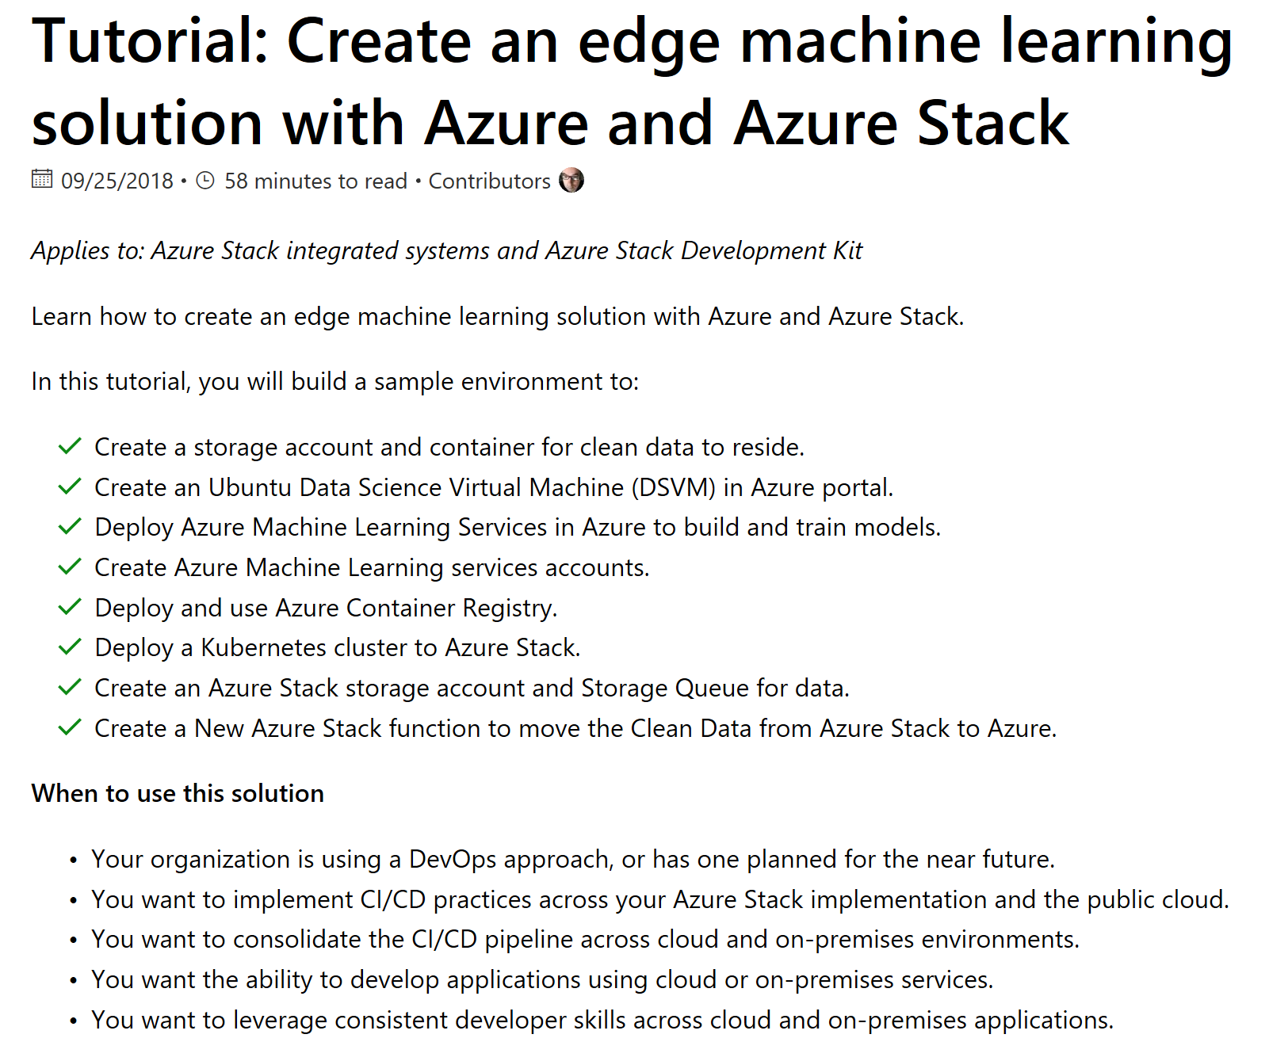
Drill down: AI at the Edge - A machine learning solution

Slide 40
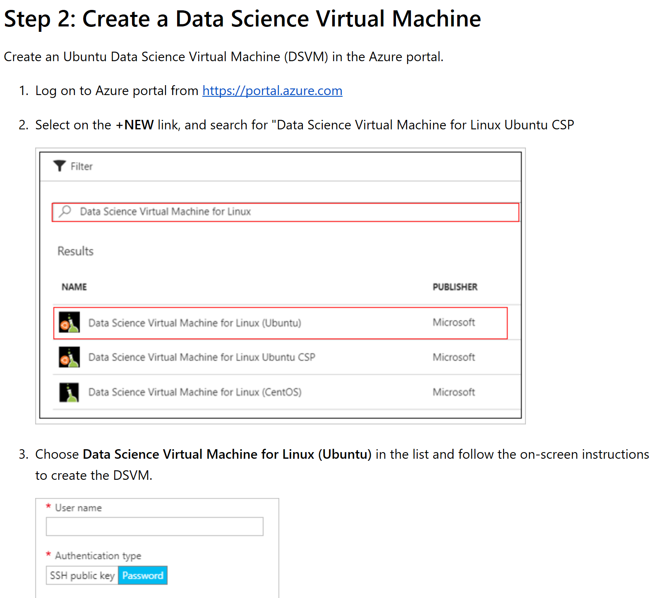

Slide 41
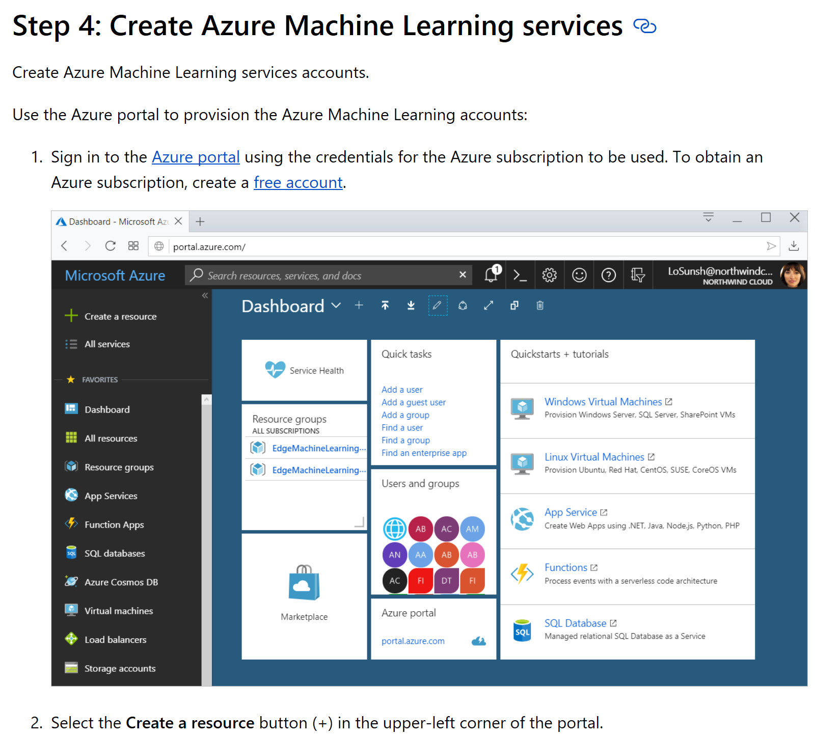

Slide 42
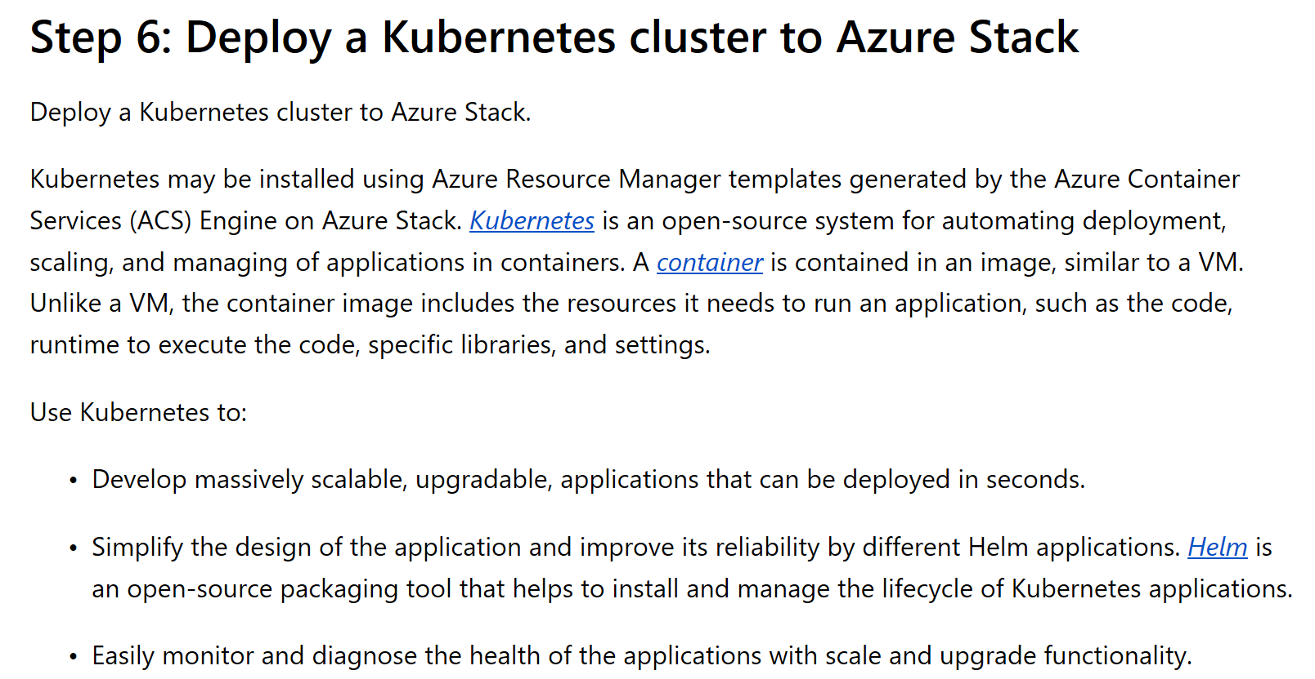

Slide 43
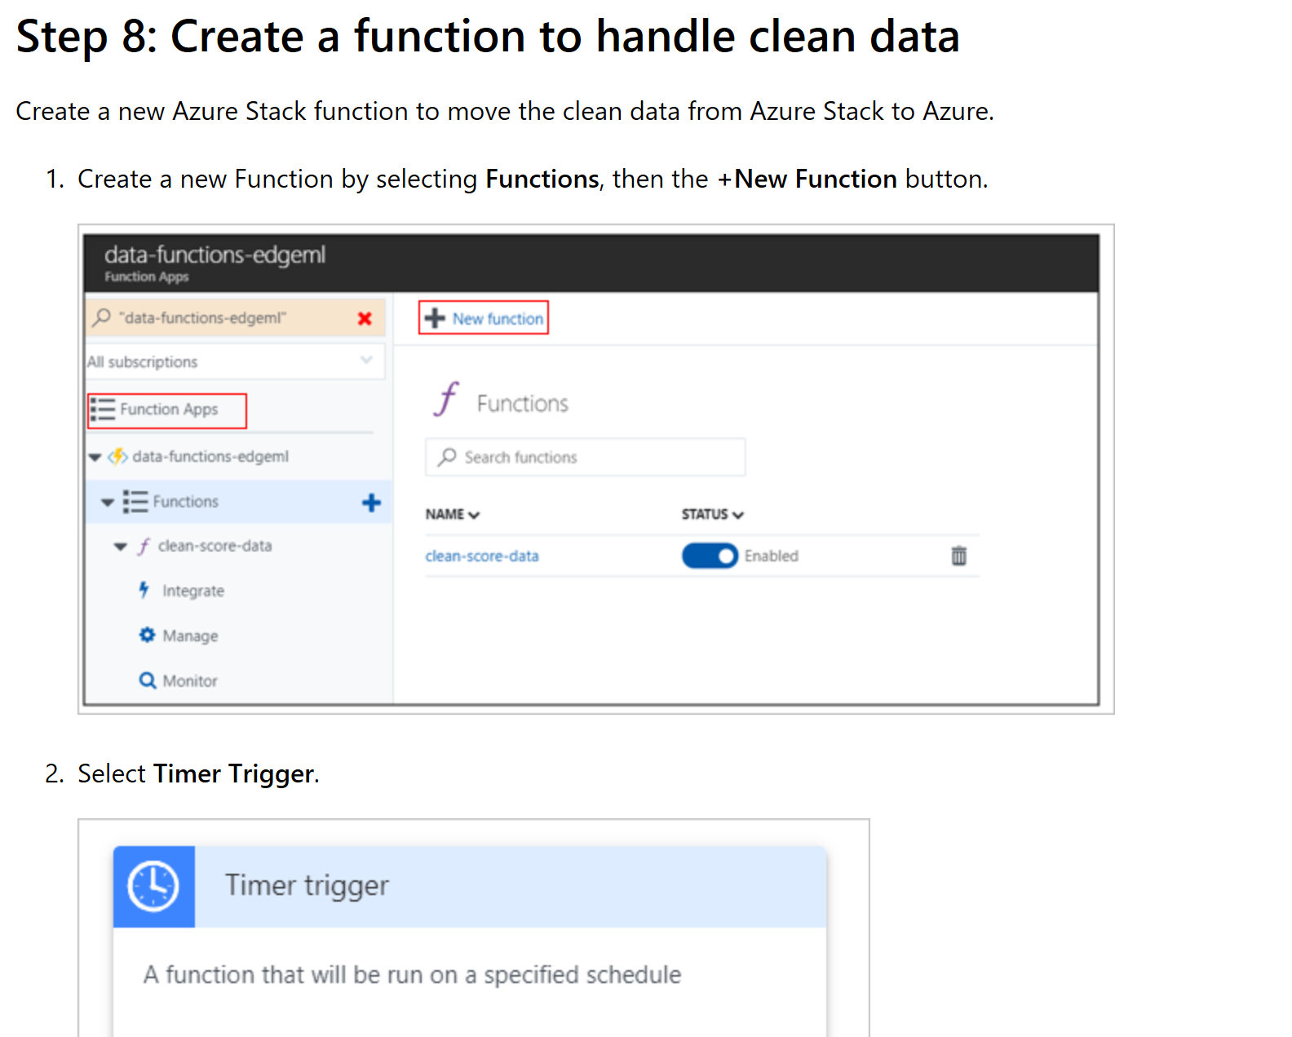

Slide 44
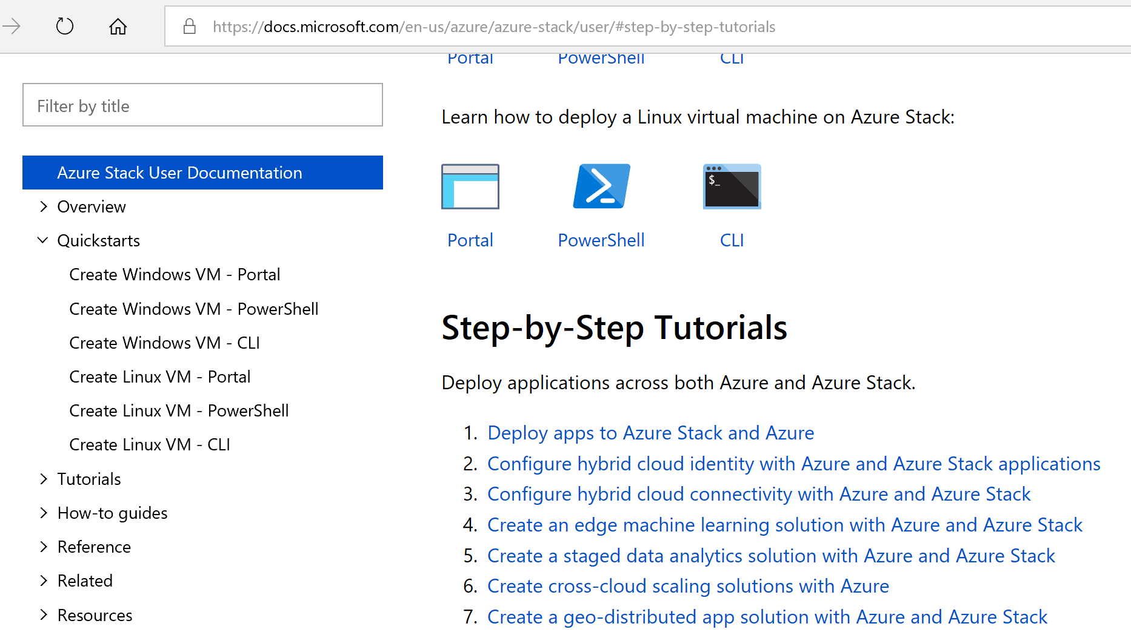
Or http://aka.ms/azsdevtutorials

Slide 45
Critical Decisions

Slide 46

Decisions you may regret later…
There are some decisions where, if you change your mind/plan later, a painful Azure Stack Hub change will be required.
These painful changes fall into two categories:
Changes that require you to redeploy Azure Stack Hub
Changes that do not require redeployment but have difficult technical or business procedures implied

Slide 47
Changes that would force redeployment
You want to switch between Azure AD and ADFS authentication
You want to use a different Azure AD tenant name for the primary/default tenant
You want to change the Azure Stack Hub Region Name (which would be part of the URL) or any part of the FQDN
You want to change the internal domain name used for Active Directory inside Azure Stack Hub (e.g. because it has the same name as an existing AD forest in your organization)
Your initial public IP address ranges need to be changed (we can add to the range, but not change the initial range). This also applies to the other IP address ranges, or removal of public ranges added after the initial range
You used self-signed certificates in the deployment and now want to move to enterprise or public certs
You used a public certificate and want to switch to an Internal CA cert (if your Azure Stack Hub is in disconnected mode, choose an internal CA cert, because you will have no connectivity to the CRL)
You chose the wrong hardware (wrong CPU family, wrong server spec, wrong storage type or storage arrangement)
You chose too many server nodes

Slide 48
Changes that would be possible but painful
Your Plans and Offers are not what you want, and tenants accepted Offers
Pointing ADFS to a new external AD
You underestimated sizing for VMs and workloads and bought insufficient capacity, and you need extra server nodes. (Painful because you need to order/receive and add server nodes, not because it is technically demanding).
Changing from static routing to BGP routing for spine (TOR) to border Devices.
If the “Firewall Throughput” for a network firewall external to Azure Stack Hub is not planned, it could affect Azure Stack Hub services and would need to be upgraded.
Transparent proxy and, in future forward Proxy (not supported yet), between border routers and Internet can become a capacity issue if not planned correctly.
Registration to Azure Subscriptions and EA - not painful to change, but then historical billing data is not in one consolidated EA
Change from capacity billing to consumption billing (you still need to pay for your capacity bill for the current period…)
Changing the target SQL database used by App Service RP

Slide 49
Tools and Tips

Slide 50
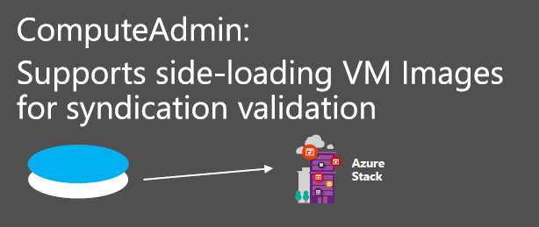
Administrator tooling
The Azure Stack Hub Tools repository also provides a number of administrator tools
Tool modules:
ServiceAdmin – Tools for creating an offer with a plan and quotas
ComputeAdmin – Tools for adding and removing VM Images
InfraAdmin – Tools for interfacing with Azure Stack Hub infrastructure actions and health monitoring

Slide 51
Template validator tool
Features:
Static analysis
Offline tool
Customizable to your Azure Stack Hub
Supports nested templates
Recommendations and warnings
Safeguards against:
Hardcoded locations
Hardcoded storage endpoints
API versions available on Azure Stack Hub
Resource types unsupported on Azure Stack Hub
Referenced content in Azure Stack Hub
Available at https://github.com/Azure/AzureStack-Tools/tree/master/TemplateValidator

Slide 52
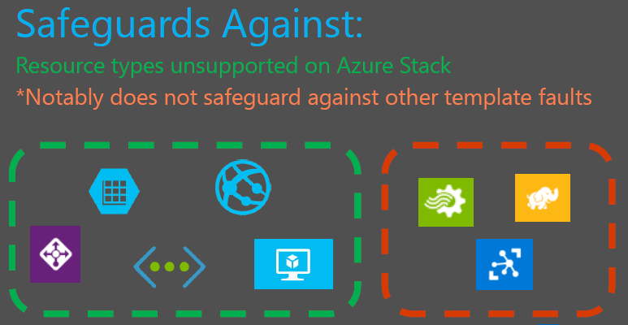
Azure Stack Hub policy tool
Features:
Policy for your Azure environment that makes Azure ‘look like’ Azure Stack Hub
Limits the resource types / namespaces that can deployed
The overall Azure Stack Hub policy capabilities will increase over time as more services onboard

Slide 53
Collect deployment logs
Cmdlet: Get-AzureStackLog
Parameter | Required / Optional | Description
OutputPath | Required | Location where a zip file containing all specified log files will be generated. Depending on the log collection scope, this can be a very large zip file. Be sure to specify a location that can hold large files.
CustomerConfigurationFilePath | Optional | The file path of the customer config file. If the cmdlet is run from the DVM’s deployment PowerShell session window, this parameter is not needed.
MaxAgeOfEventsInHours | Optional | When specified, this will filter out any Windows Event logs previous to the specified number of hours. Default value is 48 hours.
FilterByRole | Optional | When specified, the cmdlet will only collect logs for the specified role names. The input can be a string[], where multiple role names can be provided. A sample list of roles include the following: NC, SLB, Gateway, ACS, WSUS, SQL, ADFS, WAS, CRP, FRP, HRP, SRP, NRP.

Slide 54
Questions?

Slide 56
Appendix

